Slide 1
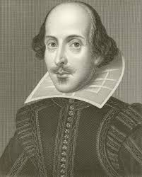
Seven Ages Of Man By
“William Shakespeare”
Playwright; poet; actor
William Shakespeare
Birth: April 1564
Death: April 1616

Slide 2
According to Shakespeare’s character Jaques in as you like it men go through seven stages in their lives:
Infancy
Schoolboy
Teenager
Young man
Middle aged
Old aged
Dotage & death

Slide 3
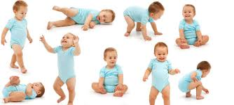
Stage 1, Infancy:
An infant (from the Latin word Infans, meaning "unable to speak" or "speechless") is the more formal or specialised synonym for baby. Infancy is defined as the first year of life and is the period of most rapid growth after birth. A helpless baby, just crying and throwing up basically.

Slide 4

Stage 2, School Boy:
This is where his formal education starts but he is not entirely happy with school. His mother is ambitious for him and has washed his face thoroughly before sending him off to school and this shiny face going to school very slowly and reluctantly.

Slide 5

Stage 3, Teenager:
The word Teenager is often associated with adolescence. The person aged between 13 and 19 years. He’s grown into his late teens and his main interest is girls. He’s likely to make a bit of a fool of himself with them. He is sentimental, sighing and writing poems to girls, making himself a bit ridiculous.

Slide 6

Stage 4, Young man:
He’s a bold and fearless soldier – passionate in the causes he’s prepared to fight for and quickly springs into action. He works on developing his reputation and takes risks to that end.

Slide 7

Stage 5, Middle aged:
He regards himself as wise and experienced and doesn’t mind sharing his views and ideas with anyone and likes making speeches. He’s made a name for himself and is prosperous and respected. As a result of his success he’s become vain. He enjoys the finer things of life, like good food. Middle age, period of human adulthood that immediately precedes the onset of old age.

Slide 8

Stage 6, Old man:
He is old and nothing like his former self – physically or mentally. He looks and behaves like an old man, dresses like one and he has a thin piping voice now. His influence slips away. Older man imply having greater age than something or someone else. Older is the usual form of the comparative of old: This building is older than that one.

Slide 9
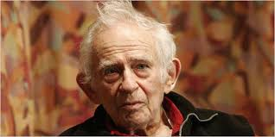
Stage 7, Dotage and death:
He loses his mind in senility. His hair and teeth fall out and his sight goes. Then he loses everything as he sinks into the oblivion of death.
Slide 01
Slide 03
Slide 05
Slide 07

Slide 10
Thanks For Watching
Presentation By
Mohammad Usama

